Slide 1
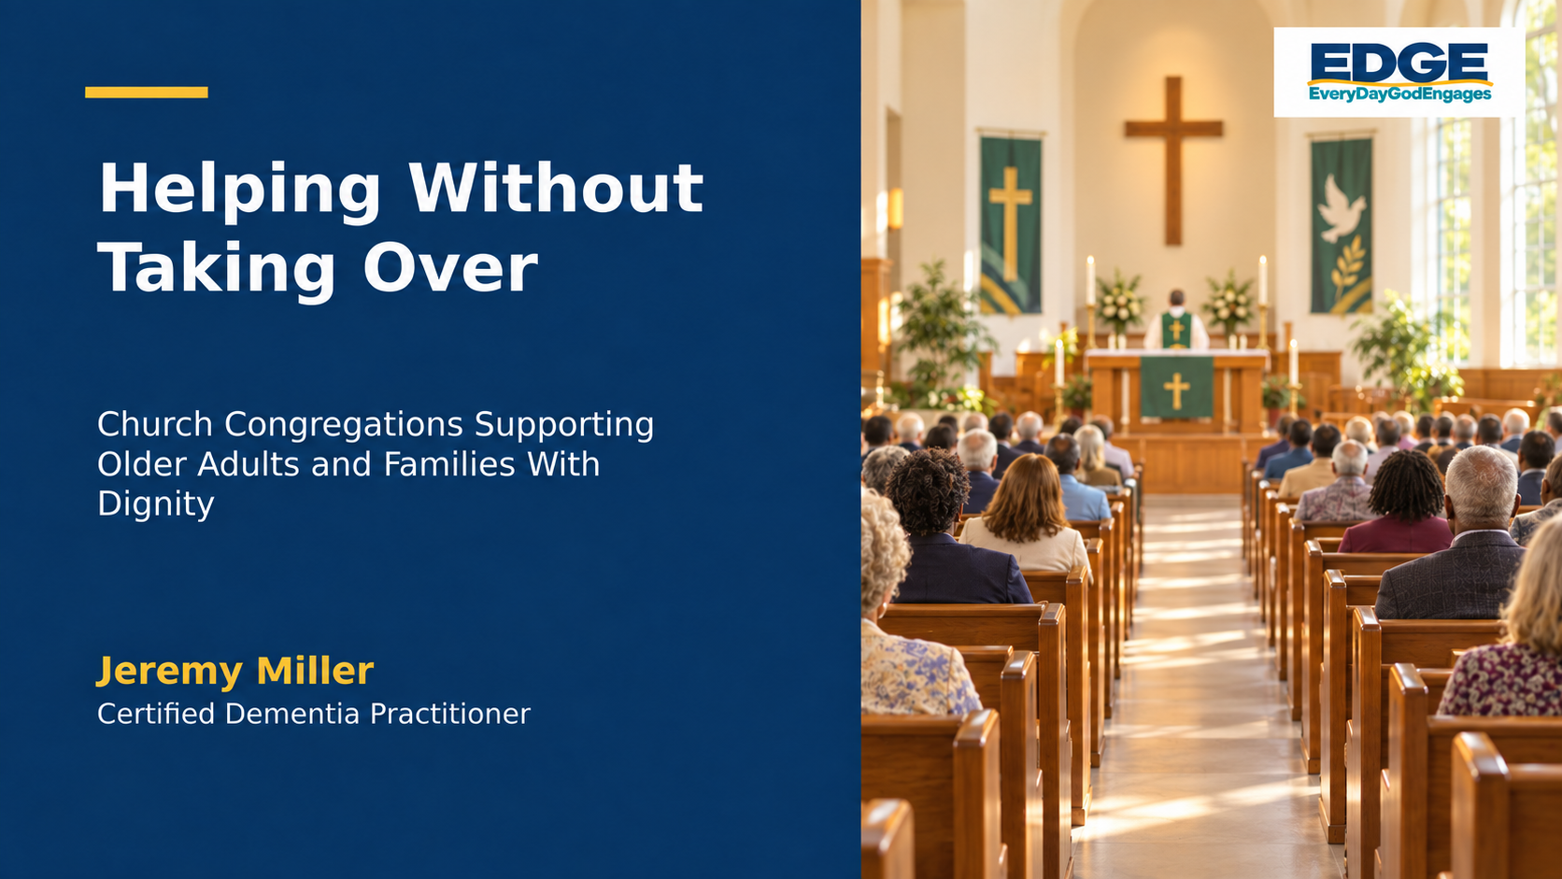
Notes:
“We want to help people in our congregation who need support because of age. Several people are slowing down or experiencing memory issues. Most have loving children, so we do not want to interrupt that. As a congregation, we want to do our part without injuring their pride.”

Slide 2

The question that began this workshop
We want to do our part without interrupting loving families or injuring anyone's pride.
How can a congregation offer meaningful support without embarrassing someone, taking control, or interfering with a loving family?
The answer begins with how we approach people.
Notes:
Read the opening concern in the participant materials. Invite the group to hear the tension in the request: the church wants to help, the family may already be involved, and the older adult's dignity must remain central.

Slide 3

What protecting pride really means
Protect the person's
Dignity
Independence
Identity
Privacy
Choices
Relationships
Purpose
Place in the congregation
Needing help does not erase a person's voice, value, or right to belong.
Notes:
Explain that the word pride can hide several deeper concerns. An older adult may need assistance in one part of life while remaining capable of making many other decisions. Support should preserve identity, choice, privacy, relationships, purpose, and belonging.

Slide 4

The church's opportunity
Notice and listen
Include and support
Recognize when someone may be struggling
Approach the person privately
Listen without making assumptions
Ask what support is wanted
Include the person in decisions
Work alongside the family
Offer spiritual, social, and practical support
Help the person remain connected to church
The church can remain present without taking over someone's care.
Notes:
A congregation may not solve every challenge connected with aging or memory loss. It can still notice, listen, ask, include, work alongside family, and help the person remain connected.

Slide 5

A model for congregational care
What do you want me to do for you?
Mark 10:51
Jesus recognized a need and still asked the person what they wanted.
What is the difference between supporting someone and taking over?
Notes:
Read Mark 10:51. Invite several brief responses to the opening question. Reinforce the key message: respectful help begins by seeing the person, speaking directly to them, and asking what they want.

Slide 6

Support the church can provide
Presence and connection
Practical help and purpose
Prayer, communion, Scripture, and pastoral visits
Listening without judgment
Telephone calls, visits, fellowship, and transportation
Ways to participate from home
Meals, accessible seating, and large print materials
Help with church responsibilities
Opportunities to serve, mentor, lead, and pray
Connections to reliable community resources
A changing role does not remove a person's purpose.
Notes:
Discuss the congregation's appropriate roles: spiritual support, emotional support, social connection, practical assistance, meaningful engagement, and connections to resources. All practical assistance should happen with permission.

Slide 7

Important boundaries
The congregation should avoid
Diagnosing dementia or another condition
Making medical, legal, financial, or family decisions
Discussing someone's situation publicly
Contacting family secretly without an immediate safety concern
Pressuring someone to accept help
Assuming adult children are uninvolved
Promising help the church cannot provide consistently
Removing responsibilities without including the person
The church notices, supports, and encourages appropriate help. Qualified professionals diagnose.
Notes:
Memory changes can have many causes. A healthcare professional must evaluate ongoing or concerning changes. Source: CDC, About Dementia, https://www.cdc.gov/alzheimers-dementia/about/index.html

Slide 8

Church roles and professional roles
Within the church's role
Requires trained professionals
Listening and prayer
Connection and inclusion
Meals and transportation
Visits and dependable referrals
Diagnosis and medical treatment
Legal or financial guidance
Personal care that requires training
Decisions about a person's capacity
Which needs belong to the church, and which need a trained professional?
Notes:
Use this as a group discussion. Ask participants to name examples from their congregation. Reinforce that the congregation remains present and supportive while respecting professional boundaries.

Slide 9

The CARE Response
C
Connect privately
A
Ask, do not assume
R
Respect the person and family
E
Engage with practical support
CARE protects dignity, choice, privacy, and family relationships.
Notes:
Introduce CARE as the framework created for this course. Ask the group to repeat each phrase aloud. Explain that CARE begins with connection and permission.

Slide 10

Connect privately
Start with connection rather than the problem
I wanted to check in and see how you are doing.
We have missed seeing you. How have things been going?
Avoid public conversations or language that suggests everyone has been discussing the person.
A private conversation gives the person control over what they share.
Notes:
If you notice a concern, approach the person privately. Avoid beginning the conversation where others can overhear. Do not say, 'Everyone has noticed that you are having problems.'

Slide 11

Ask, do not assume
Useful questions
Is anything making it more difficult for you to participate?
Would you like some assistance?
How would you like us to help?
What would make church easier for you?
The person may welcome one kind of help while declining another.
Notes:
Do not decide what a person needs based only on age, appearance, diagnosis, or one observation. Ask open questions and allow the person to decide what support feels useful.

Slide 12

Respect the person and family
Respect the person
Respect relationships
Speak directly to the older adult
Allow time for an answer
Include the person in decisions
Accept when help is declined
Protect private information
Recognize the family's existing role
Ask permission before contacting anyone
Keep acknowledging the person when communication is difficult
Is there someone you would like us to include in this conversation?
Notes:
Respect requires speaking to the person rather than around them. Ask permission before including someone else. Continue addressing the person even when memory or communication becomes difficult.

Slide 13

Engage with practical support
Make the offer specific
Instead of
Try
Let us know if you need anything.
Would it help if someone called each week?
Transportation
A meal
Home communion
A visit or telephone call
Accessible materials or seating
Support for the caregiver
Offer only what the church can provide safely and consistently.
Notes:
Once the congregation understands what the person wants, offer one or two realistic choices. Specific offers reduce the number of decisions facing an overwhelmed person or caregiver.

Slide 14

CARE in practice
An older member has missed several Sundays
We have missed you and wanted to check in. Is anything making it difficult for you to attend? Would you like support from the church? Is there anyone in your family you would like us to include?
Possible support: transportation, a home visit, communion, or another way to remain connected
Connection and permission come before solutions.
Notes:
Use this as a model, not a script that must be repeated word for word. Ask the group to identify where each CARE element appears in the conversation.

Slide 15

What memory changes may feel like
The person may struggle to
The person may feel
Remember recent conversations
Follow several instructions
Recognize a person or place
Adjust to unexpected changes
Filter noise and distractions
Explain a need or feeling
Embarrassed
Frustrated
Frightened
Overwhelmed
The church responds with dignity and safety. Healthcare professionals evaluate the cause.
Notes:
Repeating stories, forgetting names, missing instructions, or appearing disoriented does not automatically mean dementia. Ongoing, worsening, or concerning changes need professional evaluation.

Slide 16

Reassurance instead of correction
Avoid
Helpful response
Public correction
Arguing or testing memory
Speaking too quickly
Talking as if the person is absent
Remain calm
Use short, clear sentences
Allow more time
Reduce noise and attention
Involve someone familiar
That's all right. Let's go together.
Respond to the need for reassurance, not the memory mistake.
Notes:
Contrast 'You already told us that' with 'I'm glad you shared that with me.' Contrast 'Don't you remember where to go?' with 'That's all right. Let's go together.'

Slide 17

When behavior becomes harmful
Examples that require a safety response
Threats and physical harm
Other immediate dangers
Hitting, pushing, kicking, or grabbing
Threatening someone
Throwing objects
Unwanted sexual touching
Using an object as a weapon
Blocking an exit
Damaging property
Following or confronting someone
Leaving the building and becoming lost
Any behavior that creates immediate danger
Compassion for the person and protection of the congregation must happen together.
Notes:
Confusion may help explain harmful behavior, but the congregation does not have to allow someone to be harmed. Introduce the need for clear procedures and designated leaders.

Slide 18

Immediate response to harmful behavior
1
Protect people
Move others away. Keep space and an exit available.
2
Reduce responders
One calm person speaks. Avoid a crowd.
3
Use simple words
Do not argue, shame, surround, or touch unexpectedly.
4
Involve someone familiar
Contact family, a caregiver, the pastor, or a trusted person.
5
Follow church procedures
Contact help and complete an incident report.
Volunteers should not attempt physical restraint without appropriate training and authority.
Notes:
Suggested language: 'You seem upset. I want everyone to be safe.' 'Let's move to a quieter place.' 'I am going to give you some space.' Move children and vulnerable adults to safety first.

Slide 19

When emergency assistance may be necessary
Someone is being assaulted
There is an immediate threat of serious harm
A weapon is present
Someone has been seriously injured
The person cannot be safely redirected
A vulnerable person is missing
The behavior may involve a medical emergency
The congregation cannot safely maintain control
Do not call law enforcement merely because someone is confused, loud, repetitive, or making others uncomfortable.
Notes:
When calling 911, explain the possible cognitive condition, the behavior, injuries, weapons, actions already taken, trusted contacts, and anything that may help calm the person. Ask whether a crisis intervention or specially trained officer is available. Source: National Institute on Aging, Caring for a Person With Alzheimer's Disease, https://order.nia.nih.gov/publication/caring-for-a-person-with-alzheimers-disease

Slide 20

Document every harmful incident
Record observable facts
Include
Use factual language
Date, time, location, and people present
Exactly what happened and what came before
The church's response and what helped
Injuries, damage, emergency calls, and family notification
Recommended follow up and who will complete it
Write: 'Mr. Smith pushed a volunteer with both hands.'
Avoid: 'Mr. Smith went crazy and became dangerous.'
Do not add rumors or an unconfirmed diagnosis
Store reports securely and limit access
Incident reports protect the person, congregation, volunteers, and family.
Notes:
Explain that documentation helps identify patterns and create a safer plan. It must never become gossip or social media discussion. Follow church policy and applicable law when sharing records.

Slide 21

A conversation with the family
Begin with care
We care about your family member and want them to remain connected.
Describe facts
State what happened without labels or conclusions.
Ask for perspective
Learn what increases distress and what helps.
Explain safety
The church must protect everyone from harm.
Plan together
Agree on support, contacts, warning signs, and next steps.
Whenever possible, include two appropriate church representatives.
Notes:
Hold the family conversation privately after everyone is safe. Appropriate representatives may include the pastor and a designated ministry or safety leader. Compassion does not require the church to minimize an assault, threat, or injury.

Slide 22

A safer participation plan
Possible supports
Clear preparation
A family member or trusted companion
Seating near a quiet exit
Shorter periods of participation
A designated quiet space
A familiar person who can respond
An emergency contact
Signs that indicate it is time to leave
Steps if harmful behavior happens again
Home or virtual ministry while a safer plan develops
Guidance from church leaders, the insurer, or legal counsel when needed
A participation plan protects belonging while addressing safety.
Notes:
If leaders consider formally restricting participation, they should consult denominational guidance, the church's insurer, and qualified legal counsel before making a final decision.

Slide 23

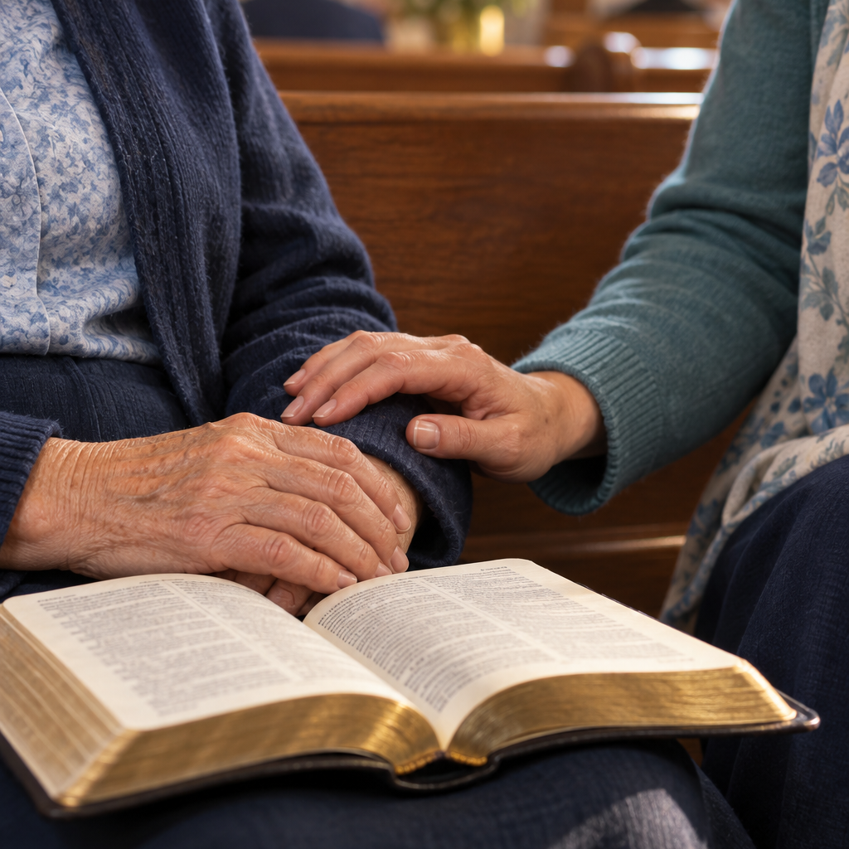
Working alongside loving families
Begin with the older adult
Ask permission before contacting relatives
Do not assume the family is uninvolved
Ask what support is already in place
Offer specific help that the family may accept, decline, or adjust
Keep the door open when help is declined
Work with the person and family, not around them.
Notes:
Adult children or other relatives may already provide transportation, meals, personal care, financial help, appointments, medication support, and regular contact. The church should strengthen that support system rather than judge or replace it.

Slide 24

Practice with church situations
Small-group questions
What might our automatic reaction be?
How could that reaction affect the person's dignity?
How could we use the CARE Response?
Should the family be contacted?
What practical support could the church offer?
Is there a safety concern?
Does anything need to be documented?
Choose one situation. Discuss for five minutes. Share one recommended response.
Notes:
Divide participants into small groups. Assign each group one situation. Give them about five minutes, then invite each group to share one recommended response.

Slide 25

Practice situations: dignity and reassurance
Assistance without permission
Repeated questions
A volunteer grabs the arm of a person using a walker and begins guiding them without asking. The person pulls away.
An older member repeatedly asks when lunch will be served. Another member responds with frustration, and the person becomes embarrassed.
I'm sorry. I should have asked first. Would you like assistance?
Lunch will be served soon. You can sit with me while we wait.
Ask before touching. Respond to the need for reassurance.
Notes:
Situation one: a person may need more time without needing physical assistance. Always ask before touching someone or moving mobility equipment. Situation two: correction does not solve the memory difficulty. A visual reminder or personal guidance may help.

Slide 26

Practice situations: connection and safety
The missing caregiver
Harmful behavior
A member has missed worship for several weeks while caring for an aging spouse. Everyone assumes the caregiver will ask for help.
A confused older adult grabs another member forcefully and threatens anyone who approaches. The family is absent.
We have missed you. Would a meal, a call, home communion, or another support help?
You seem frightened. I want everyone to be safe. I am going to give you space.
Compassion remains essential, and safety needs immediate attention.
Notes:
For the caregiver situation, discuss specific ways to maintain connection. For harmful behavior, one calm leader speaks while others move people to safety. Call 911 when the threat cannot be safely managed, serious harm appears likely, a weapon is present, or someone is injured. Document the incident and contact the family privately.

Slide 27

Learning from the practice situations
Our first reaction might have been __________, but a CARE Response would be __________.
Which situation felt most difficult?
Where are we most likely to make assumptions?
Do volunteers know who to contact?
Does the church have an incident report process?
What preparation would help us respond with confidence?
What can we change before one of these situations occurs?
Helpful responses protect dignity, respect families, and address safety.
Notes:
Bring the groups back together. Ask each group to complete the statement and share one answer. Use the questions to identify gaps in volunteer preparation and church procedures.

Slide 28

One congregational action
What is one area where our congregation is currently least prepared?
Begin with one need, one realistic action, and one person responsible for moving it forward.
Awareness becomes meaningful when the congregation follows through.
Notes:
Allow the group to identify the need that feels most important and realistic. Possible needs include private conversations, family communication, absent caregivers, confusion during worship, volunteer training, accessibility, documentation, safety response, resources, and meaningful engagement.

Slide 29

Possible first actions
Preparation
Connection
Train greeters, ushers, and ministry leaders in CARE
Create a private process for reporting concerns
Develop an incident report form
Establish a safety response plan
Contact caregivers who have stopped attending
Complete an accessibility review
Create a reliable community resource list
Invite older adults and caregivers to help shape the plan
Choose an action the church can complete and review.
Notes:
Discuss which first action fits the congregation's current needs and capacity. The goal is not to create an entire aging ministry today.

Slide 30

The congregational action plan
The need we are addressing
The action we will take
The person or team responsible
The people who should be consulted
The first step
The date we will review progress
Ask older adults and caregivers: Would this help? What are we overlooking?
Notes:
Help the group make its action specific. A clear action answers what will happen, who will lead, who must be included, when it will begin, how completion will be measured, and when progress will be reviewed.

Slide 31

The CARE commitment
C
Connect privately
A
Ask, do not assume
R
Respect the person and family
E
Engage with practical support
We will notice, listen, ask, respect, and respond. We will support older adults without taking over, work alongside loving families, protect dignity and safety, and offer only the help we can provide responsibly and consistently.
Notes:
Invite participants to read the commitment together. Then ask: What idea stood out? What reaction needs to change? What is the church already doing well? What action has the group agreed to take?

Slide 32

Faithful presence
Be devoted to one another in love. Honor one another above yourselves.
Romans 12:10
The church does not need to take over someone's care to remain faithfully present in their life.
May older adults and caregivers remain seen, heard, encouraged, included, and connected.
Notes:
Close with prayer: God, thank You for every older adult, caregiver, and family within our congregation. Help us notice without judging, ask before helping, listen with patience, work alongside loving families, respond calmly to memory changes, and protect people when safety becomes a concern. Guide us as we turn caring intentions into faithful action. May older adults and caregivers remain seen, heard, encouraged, included, and connected. Amen.

