Slide 1
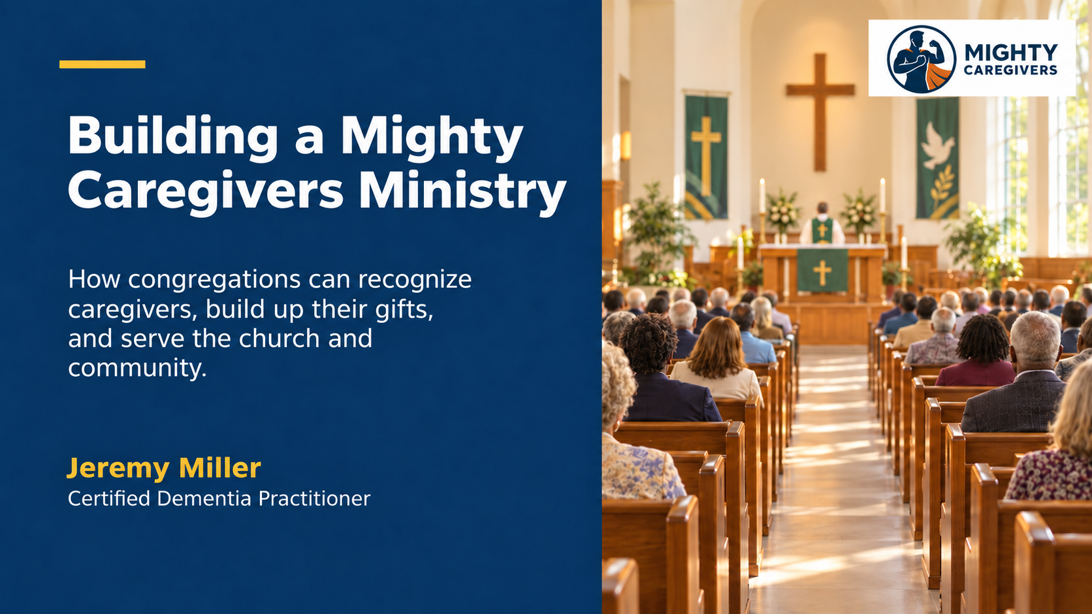

Slide 2

The purpose of this workshop
Recognize
Build up
Connect
caregivers already present
their gifts and capacity
care with church and community needs
Mighty Caregivers creates a church culture where caregivers are seen, heard, encouraged, and connected.
What do we hope people experience when they need care from our congregation?
Notes:
Explain that the workshop will focus on three movements: recognizing people, building them up, and connecting their gifts with meaningful service. Invite two brief responses to the question at the bottom of the slide.

Slide 3
The people God has already gathered
Churches often hope new families will arrive.
Some members are slowing down.
Some are caring for others.
Some feel overwhelmed.
That hope can exist alongside an immediate calling.
The present congregation already includes caregivers, neighbors, retired professionals, people with lived experience, and members who can offer small acts of care.
How can Christ work through the people who are here now?
Notes:
Acknowledge the hope many churches have for families with children to join. Then bring attention to the congregation’s current reality. Current members carry gifts and needs at the same time. Mighty Caregivers helps the church see people who are already present rather than waiting for a different congregation to arrive.

Slide 4
Who is a caregiver
A caregiver notices another person’s need and responds with care.
Presence
Sitting with someone who feels alone or uncertain
Practical help
Meals, transportation, repairs, technology, or paperwork
Encouragement
Prayer, listening, calls, visits, or cards
Connection
Helping a person reach a church ministry or community resource
Many people care for others without calling themselves caregivers.
Notes:
Expand the congregation’s understanding of caregiving. Caregiving includes daily family care, but it also includes smaller acts of presence, help, encouragement, and connection. Ask participants to consider which of these forms of care they already provide.

Slide 5
Caregivers we may overlook
01
A spouse or adult child who says, “I am only helping my family.”
02
A person whose health limits physical service but who can pray, call, organize, or encourage.
03
A person who received care and understands what respectful support feels like.
Who may be caring quietly in your congregation?
Notes:
Protect privacy during the conversation. Invite participants to name types of caregivers rather than specific people or private situations. Emphasize that a person can contribute without providing hands-on care.

Slide 6
Edify the caregivers
EDIFY
Build up Strengthen Encourage
Ephesians 4:12 connects the work of the church with equipping God’s people for service and building up the body of Christ.
Caregivers need support as well as opportunities to serve.
What would help a caregiver feel seen and strengthened?
Notes:
Define edify as building up, strengthening, and encouraging. Connect the word with Ephesians 4:12. Explain that a caregiving ministry must care for the caregivers themselves, not only recruit them to complete tasks.

Slide 7
Specific support is easier to receive
“Let us know if you need anything.”
A clear offer removes one more decision from an overwhelmed caregiver.
A call
May I call Thursday to see how you are doing?
A meal
Could we bring dinner on Tuesday?
A break
Could someone cover your church responsibility this month?
The caregiver remains free to accept, decline, or adjust the offer.
Notes:
Explain why open-ended offers can create another task for the caregiver. Encourage the congregation to make one clear, manageable offer and respect the person’s response.

Slide 8
Care within our capacity
A healthy ministry asks two questions
What can I offer reliably?
What limits must others respect?
Small, scheduled, shared service protects volunteers and the people receiving care.
A dependable fifteen-minute call can matter more than an open-ended promise.
Notes:
Invite people to think about their health, schedule, family responsibilities, and energy. Explain that limits support dependable ministry. A person can give care in one season and receive it in another.

Slide 9
More than hands-on care
Listen and pray
Conversation, encouragement, worship support, and prayer
Organize
Schedules, volunteer coordination, follow-up, and resource lists
Teach and connect
Short classes, lived experience, community contacts, and referrals
Offer practical help
Meals, rides, home tasks, calls, visits, or technology
The goal is to help many people discover one meaningful way to care.
Which caregiving gift do you recognize in yourself?
Notes:
Describe the wide range of gifts a Mighty Caregivers ministry can use. Encourage participants to consider both direct service and behind-the-scenes roles. Avoid asking people to disclose private experiences unless they choose to share.

Slide 10
From individual care to shared ministry
Kind acts already happen throughout the church.
A ministry gives people a trusted way to share a need, offer a gift, coordinate a response, and follow up.
Build on what already exists
Create the smallest structure needed
Meals, visits, prayer, calls, transportation, and existing church ministries
A coordinator, backup, clear roles, a request process, and regular review
Notes:
Explain that Mighty Caregivers should connect and strengthen existing care rather than compete with current ministries. The church can begin with a light structure that gives people clarity and support.

Slide 11

A simple ministry pathway
01
NOTICE
Create respectful ways to share a need
02
LISTEN
Learn what the person wants
03
CONNECT
Match the need with a volunteer, ministry, or resource
04
SUPPORT
Give clear expectations and backup
05
FOLLOW UP
Ask what helped and what should change
Listening comes before deciding what the church should do.
Notes:
Walk through the five steps. Emphasize that the person receiving support participates in decisions. The process should remain easy to understand and should include follow-up with both the caregiver and the volunteer.

Slide 12
Healthy ministry foundations
Leadership
A coordinator, a backup, and support from church leaders
Clear roles
Volunteers understand the request, their limits, and who to contact
Privacy
Share personal information only with permission and a ministry purpose
Boundaries
Refer medical, legal, protective, or emergency needs to qualified help
Review
Check whether the support helped and whether capacity has changed
Prayer and concern should never become gossip.
Notes:
Describe the safeguards that help a ministry remain trustworthy. Mighty Caregivers can offer presence, spiritual care, practical support, and connection. It should not replace families or professional services. Follow church policy for privacy, safety, screening, transportation, and emergencies.

Slide 13
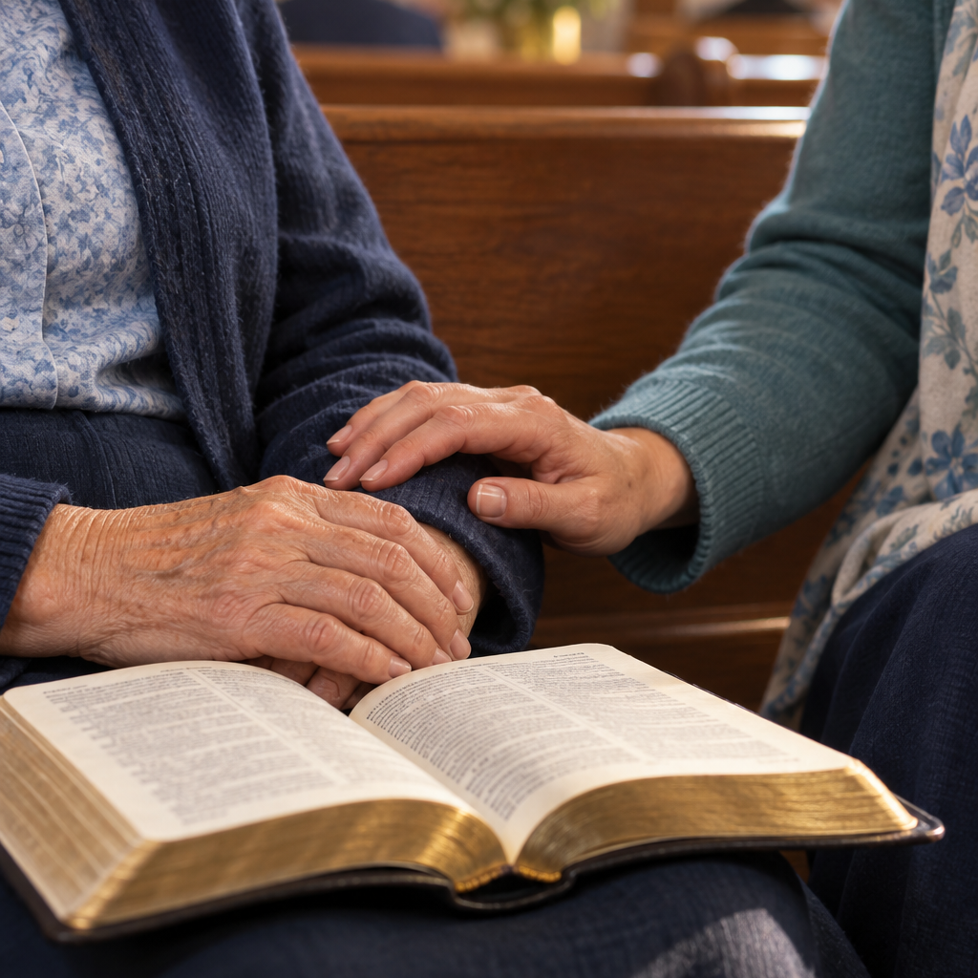
Serving the church and community
The church brings
Faith
Relationships
Compassion
Practical gifts
A willingness to listen
Community partners bring specialized knowledge, programs, and services.
Which community partner could strengthen your church’s care?
Notes:
Explain that the church does not need to duplicate professional services. Potential partners include other churches, aging and disability organizations, schools, healthcare providers, veterans’ groups, libraries, food programs, and mental health or recovery organizations.

Slide 14
The first 90 days
Choose one action the congregation can complete.
Listen
Invite caregivers to describe what support would help
Organize
Form a small team or identify a coordinator and backup
Connect
Create a resource guide or meet with a community partner
Pilot
Try one monthly gathering, call team, or care response
Name the owner Choose the first step Set a review date
What can your congregation begin responsibly?
Notes:
Ask the group to choose a manageable action rather than design the entire future ministry. Examples include a listening session, gifts survey, planning team, resource guide, caregiver gathering, or partnership meeting. The group should identify an owner, backup, first step, and review date.

Slide 15
Our congregational commitment
We will recognize the caregivers God has already placed among us.
We will listen to their experiences, build up their gifts, respect their limits, and make room for them to receive care as well as give it.
We will develop Mighty Caregivers as a ministry that strengthens our congregation and carries Christ’s care into the community.
We will serve responsibly, work with trusted partners, and offer what we can provide faithfully and consistently.
Jeremy Miller (412) 480-4369 edgemightycares@gmail.com
Notes:
Invite the congregation to read the commitment together. Close with prayer, thanking God for the caregivers already present and asking for wisdom to recognize gifts, serve within healthy limits, and carry Christ’s care into the community. Let participants know that follow-up guidance remains available through Mighty Caregivers Ministry.

